Slide 1
Team Game stoppers
Nick Roach
David Fan
Luke Motley
Farida Mohiuddin-Jacobs

Slide 2
Topic: does game stop represent new trend of meme stocks
Stock prices are not solely the result of the quality of a company, but are more specifically, based on the perceived quality of a company.
If there’s enough people who see, spread and act based off what they see on social media, it can grow to become an equally powerful contributor to stock prices as actual business reports.
Large media platforms seem to draw sentiments where mass communities can form based around a stock or idea. These communities strengthen and reinforce these sentiments causing waves of high volatility and price surges and dips.
An example occurred when Game Stock had rocketed to $483.00 on January 28th, 2021

Slide 3
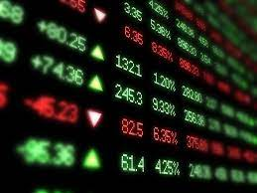
reason for our topic
Over the past year stocks such Game Stop and AMC have seen a significant spike in stock price influenced by social media platforms such as reddit and twitter.
This new trend inspired us to do a deep dive analysis, to figure out how much impact these platforms have and on the price fluctuation in the stock market.

Slide 4
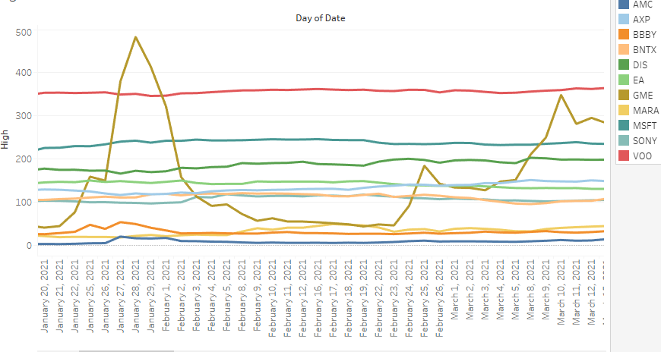
Questions we hope to answer with the data
How is the stock market affected by the surges and dips of Game Stop(GME)?
Are certain stocks more correlated in price changes to GME?
How is GME and AMC correlated? Could these price changes be predicted as a new meme stock growing

